Slide 1

How did Internet affect the Fortune 500 ???
Gunjan Sood

Slide 2
Objective
The aim of this project is to analyze the relationship between internet boom and change in structure of the Fortune 500.
Mean revenue, minimum revenue, maximum revenue, some other statistical measures & their ratios and how one of these affects the others will be critical in our analysis.
Secondary objective is to provide useful insights and trends for investors & companies.

Slide 3
About the Data
The data set used is based on revenue of Fortune 500 Companies from 1955 to 2021. (Taken from Kaggle). The data has the following features:
Year – Year for which the revenue is reported
dtype: Integer
Name – Name of the company
dtype: String
Revenue – Revenue earned by the company in a particular year (in millions)
dtype: Float
Rank – Rank based on revenue earned
dtype: Integer
Is tech Company – Whether company operates in the technology/internet sector (I added this column by scrapping “Industry” from Wikipedia)
dtype: Bool as Integer (0 or 1)
https://www.kaggle.com/darinhawley/fortune-500-companies-19552021

Slide 4
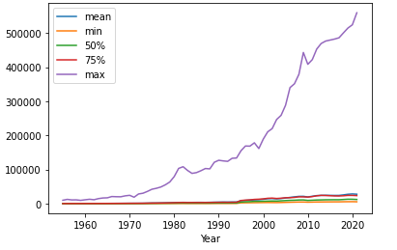
Initial Analysis
The following two graphs suggest that the data is skewed.
This plot shows that the max value is considerably higher than the other statistics.
It also helps us in inferring that the variance in data in the first 3 quartiles (0 to 75%) is much lesser than that in the complete dataset. In other words, there are high value outliers in the top (or, fourth) quartile.

Slide 5
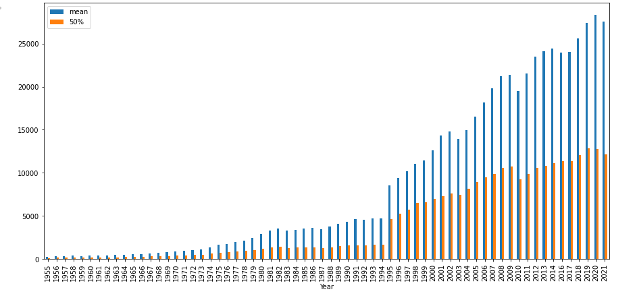
This plot illustrates that the mean and median have a pretty significant difference.

Slide 6
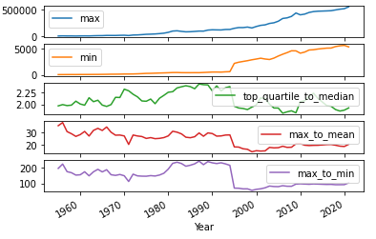
Road to Hypotheses
Based on the initial analysis, I figured that there’s a huge disparity in revenue amongst the fortune 500 companies. So, I decided to analyze the ratio of maximum revenue earning company to minimum revenue earning company for each year (which is referred to as max-min ratio hereafter).
The trend in the ratio showed that the disparity reduced significantly around 1995 which happens to coincide with era of internet boom. This led to the following two hypothesis.

Slide 7
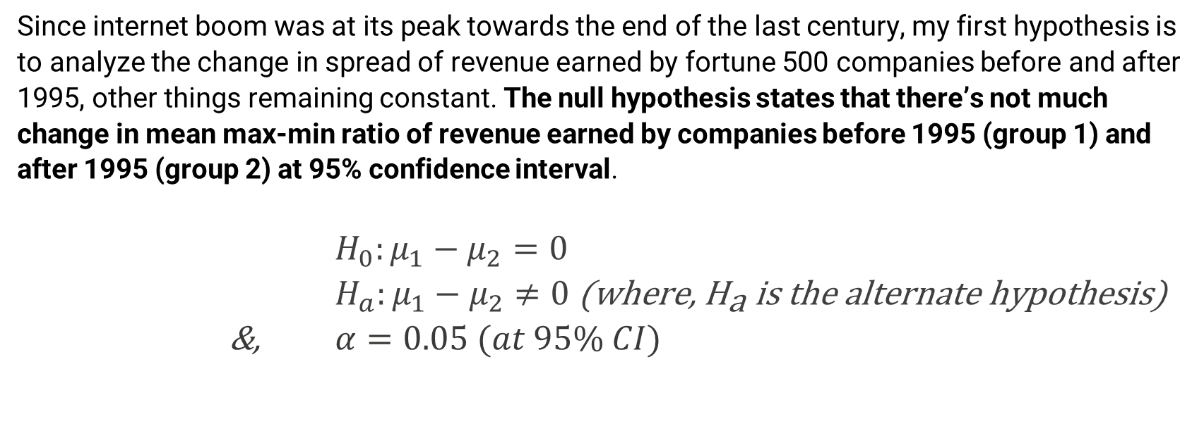
Hypothesis 1
Since internet boom was at its peak towards the end of the last century, my first hypothesis is to analyze the change in spread of revenue earned by fortune 500 companies before and after 1995, other things remaining constant. The null hypothesis states that there’s not much change in mean max-min ratio of revenue earned by companies before 1995 (group 1) and after 1995 (group 2) at 95% confidence interval.
$H_{0}:μ_{1}−μ_{2}=0$ $H_{a}:μ_{1}−μ_{2}≠0 \text{(}\text{where}\text{, }{\text{H}}_{\text{a}} \text{is} \text{the} \text{alternate} \text{hypothesis}\text{)}$
&, $α=0.05 (at 95\% CI)$

Slide 8
Result of t-test & Interpretation
 | Mean Value (of max : min ratio)
Group before 1995 | 187.2787
Group after 1995 | 83.4333
T- statistic | 16.4802
P-value | 1.0545e-22
We can see that the t-statistic > critical value(=1.96), so we can safely reject the null hypothesis that there's no difference between max : min revenue ratio of the two groups. Also, since the p-value < 0.05, we can say that the difference is statistically significant at 95% confidence interval.
Thus, this test clearly shows that there has been a significant change in the mean max : min revenue ratios of Fortune 500 companies before & after 1995.

Slide 9
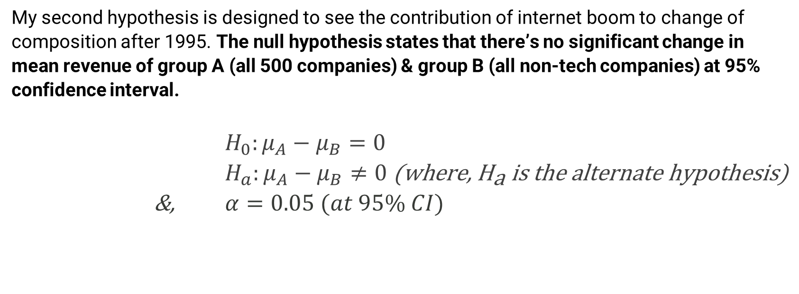
Hypothesis 2
My second hypothesis is designed to see the contribution of internet boom to change of composition after 1995. The null hypothesis states that there’s no significant change in mean revenue of group A (all 500 companies) & group B (all non-tech companies) at 95% confidence interval.
$H_{0}:μ_{A}−μ_{B}=0$ $H_{a}:μ_{A}−μ_{B}≠0 \text{(}\text{where}\text{, }{\text{H}}_{\text{a}} \text{is} \text{the} \text{alternate} \text{hypothesis}\text{)}$
&, $α=0.05 (at 95\% CI)$

Slide 10
Results of t-test & interpretation
T-statistic | 0.3113
P-value | 0.7568
The above case shows that we fail to reject the null hypothesis, since the t-statistic < critical value at 95% C.I. level.
Also, the p-value > 0.05, the results are not statistically significant.
One possible reason for this could be the relatively small share (<5%) of tech-based companies (resulting in the list of non-tech companies being almost identical to the entire list of companies).

Slide 11
So, instead of comparing all companies to non-tech companies I decided to compare all companies to tech companies.
Now, the hypothesis alters as follows:
The null hypothesis can be formulated to state that there’s no significant change in mean revenue of group A (all 500 companies) & group B (all tech companies) at 95 % Confidence Interval.
Results of t-test & Interpretation:
T-statistic | 5.3163
P-value | 8.6689e-7
It can be inferred from these test results that the mean revenue of tech companies is not equal to all Fortune 500 companies. Also, p-value(=8.6689e-07) implies the results are statistically significant.

Slide 12
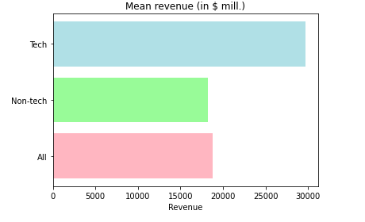
Tech Companies Vs Others
Mean revenue for tech companies: | $ 29743.280286668374 (mill.)
Mean revenue for all companies: | $ 18783.912819917998 (mill.)
Mean revenue for non-tech companies: | $ 18257.212124034526 (mill.)

Slide 13
Inferences & Conclusions:
There was great disparity in revenue between the first three quartiles (0-75%) & last quartile (75-100%) of the Fortune 500 companies before 1995.
There's been significant fall in the difference of maximum revenue and minimum revenue around mid 1990s.
The shift in the structure coincides with the Internet boom, i.e around mid 1990s.
Larger share of tech companies entered the Fortune 500 during and/or after the 1990s.
Revenue of tech companies is significantly higher, but they haven't been able to influence the Fortune 500 composition much because their share hasn't increased very much.

